Slide 1
SQL Update and Delete queries, Auto Increment
Pradnya dabhade

Slide 2
SQL Update queries
The UPDATE statement is used to modify the existing records in a table.
By default the SQL_SAFE_UPDATE is on, to make any updation we have to set the update mode to off
SET SQL_SAFE_UPDATES = 0;
UPDATE table_name SET column1 = value1, column2 = value2, ... WHERE condition;
SET SQL_SAFE_UPDATES = 1;

Slide 3
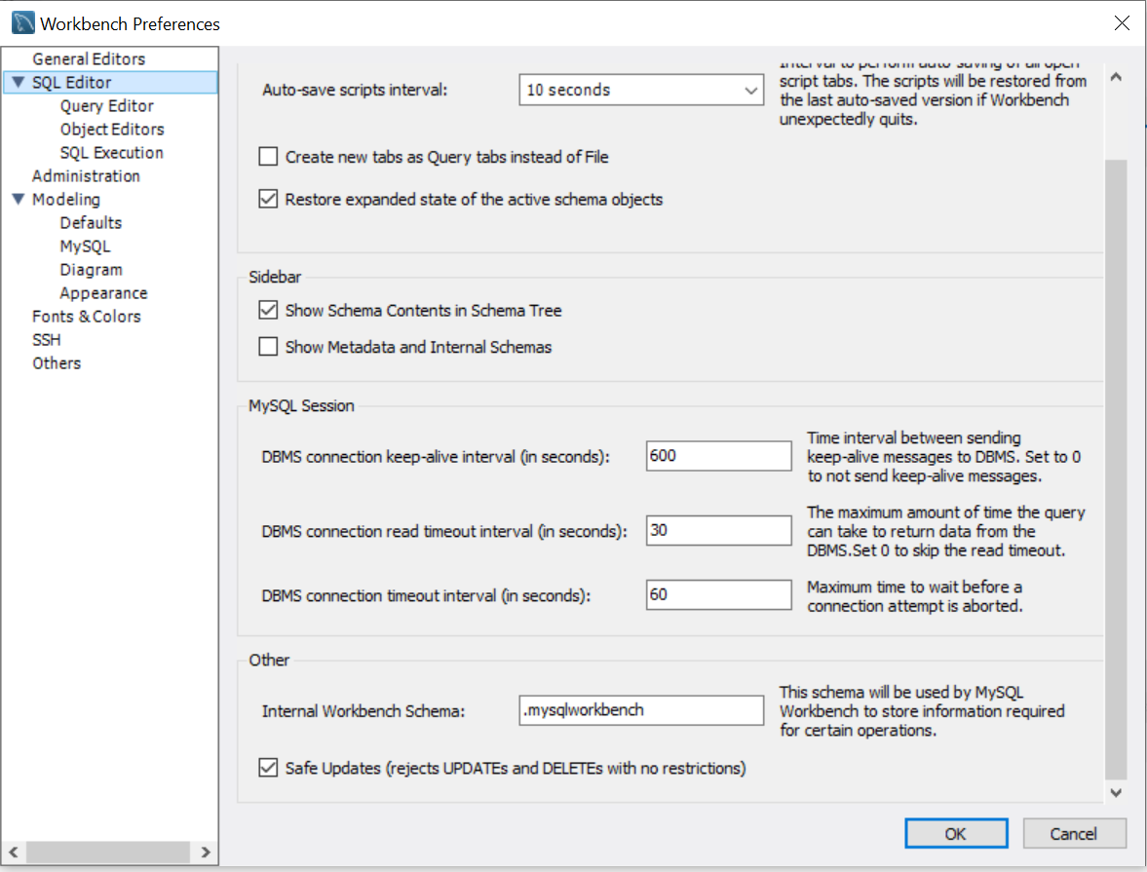
Toggle between SQL_SAFE_UPDATES
Edit
Preferences
SQL Editor
Safe Updates

Slide 4
Be careful when updating the records it will update entire column if WHERE clause is not used
Difference between Update and Insert into
Insert is used to add new entry in the table
Update is used to update an existing entry in the table

Slide 5
SQL Delete queries
MySQL DELETE statement is used to remove records from the MySQL table that is no longer required in the database.
This query in MySQL deletes a full row from the table and produces the count of deleted rows.
DELETE FROM table_name
WHERE condition;

Slide 6
MySQL DELETE and LIMIT Clause
MySQL Limit clause is used to restrict the count of rows returns from the result set, rather than fetching the whole records in the table.
Sometimes we want to limit the number of rows to be deleted from the table; in that case, we will use the LIMIT clause as follows:
DELETE FROM table_name
WHERE condition
ORDER BY colm1, colm2, ...
LIMIT row_count;
Note: we should always use the ORDER BY clause while using the LIMIT clause.

Slide 7
SQL Auto Increment while creating id
The auto-increment is an attribute in MySQL that allows a unique number to be automatically generated when new records are added to a table.
CREATE TABLE table_name(
column1 int not null auto_increment
column2 …
primary key (column1)
);
By Default auto increment starts by 1 and increases by 1 every time

Slide 8
Thank you

